Slide 1
Introduction to Access - Part 3
Relationships
Relationships Between Tables (Joining Tables)
Referential Integrity
Normalization
Backing up a Database
Compacting and Repairing a Database

Slide 2
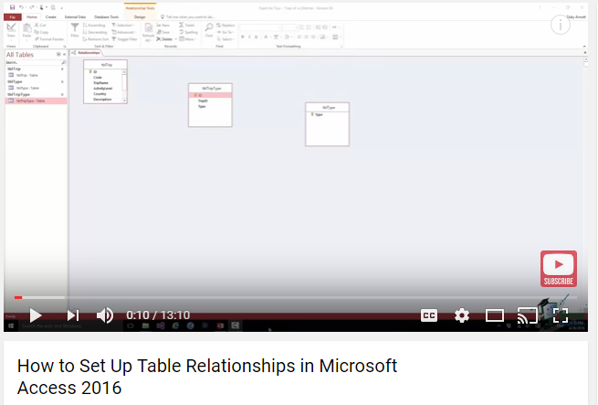
Overview of Relationships in Access
https://www.youtube.com/watch?v=XHwy7Z5Twho

Slide 3
Relationships Are Important
Critical advantage of Access over Excel is relationships
Can keep complex information working smoothly without a lot of space or complexity.
Allow normalization by keeping information in one place only.

Slide 4
Creating Relationships
A common field (variable) is used to connect two tables together. One table has the primary key and the second has the foreign key. The four-way test determines which fields are most appropriate to tie two tables together. They do not need to be named the same. A database may have many primary and foreign keys if there are many tables. A fundamental difference between spreadsheets and databases is the concept of tying tables together via primary and foreign keys.
Notes:
A common field is used as a connection between two tables.
When joining two tables, join lines allow the user to create a relationship between two tables using the common field. Once the join lines are there, you can determine what type of relationship you want the two tables to have.
There are three types of relationships to determine how Access will manage the relationship between two tables:
Enforce referential integrity
Cascade update related fields
Cascade delete related records
We’ll cover the first one in this chapter, but the last two will be covered in Chapter 2.

Slide 5
4-Way Test to Determine Table Relationships
Here is how you know that two fields are related:
In the Excel worksheet are the two fields logically connected?
In the Excel worksheet are the two fields the same range?
In the Access database is one field a primary key?
In the Access database are the two field properties the same?

Slide 6
4-Way Test to Determine Relationships
1) In the Excel worksheet are the two Mem# fields logically connected?
Mem# | Name | Address | City | ST | Zip | Phone
1 | Portia Mcfann | 4891 Pacific Hwy | San Diego | CA | 92110 | 858-294-0682
2 | Andrew Fenstermacher | 2400 N Jefferson St | Perry | FL | 32347 | 850-584-7434
3 | Brady Tatum | 710 N Cable Rd | Lima | OH | 45805 | 419-222-8541
4 | Gracie Riskalla | 5345 Madison Ave | Sacramento | CA | 95841 | 916-344-7735
5 | Helga Rio | 5108 W Gore Blvd | Lawton | OK | 73505 | 580-357-0385
6 | Shirley Keams | 8 N Water St | Nantucket | MA | 2554 | 508-228-6114
7 | Willie Coughenour | 1715 Saint Marys Ave | Parkersburg | WV | 26101 | 304-422-8589
Mem# | Dues | Payments
1 | 125 | 118
2 | 125 | 125
3 | 125 | 86
4 | 125 | 53
5 | 125 | 70
6 | 125 | 95
7 | 125 | 93

Slide 7
4-Way Test to Determine Relationships
2) In the Excel worksheet are the two fields the same range?
Mem# | Name | Address | City | ST | Zip | Phone
1 | Portia Mcfann | 4891 Pacific Hwy | San Diego | CA | 92110 | 858-294-0682
2 | Andrew Fenstermacher | 2400 N Jefferson St | Perry | FL | 32347 | 850-584-7434
3 | Brady Tatum | 710 N Cable Rd | Lima | OH | 45805 | 419-222-8541
4 | Gracie Riskalla | 5345 Madison Ave | Sacramento | CA | 95841 | 916-344-7735
5 | Helga Rio | 5108 W Gore Blvd | Lawton | OK | 73505 | 580-357-0385
6 | Shirley Keams | 8 N Water St | Nantucket | MA | 2554 | 508-228-6114
7 | Willie Coughenour | 1715 Saint Marys Ave | Parkersburg | WV | 26101 | 304-422-8589
Mem# | Dues | Payments
1 | 125 | 118
2 | 125 | 125
3 | 125 | 86
4 | 125 | 53
5 | 125 | 70
6 | 125 | 95
7 | 125 | 93

Slide 8
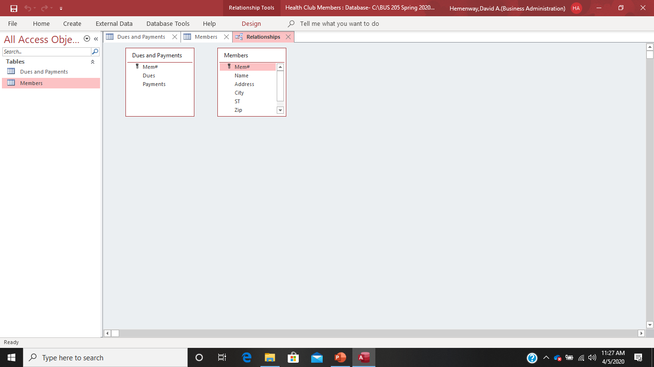
4-Way Test to Determine Relationships:
3- In the Access database is one field a primary key?

Slide 9
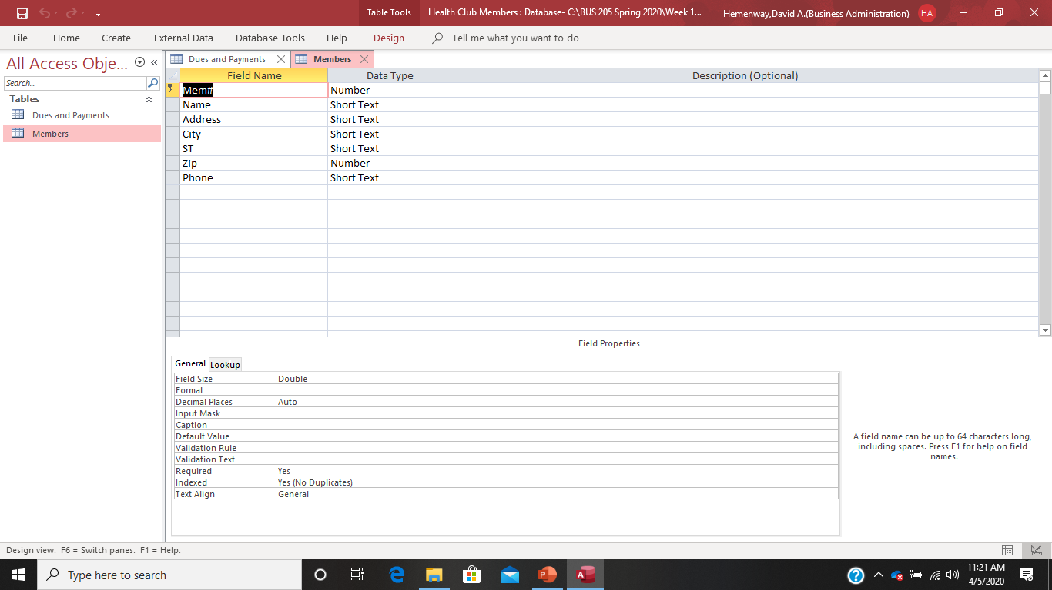
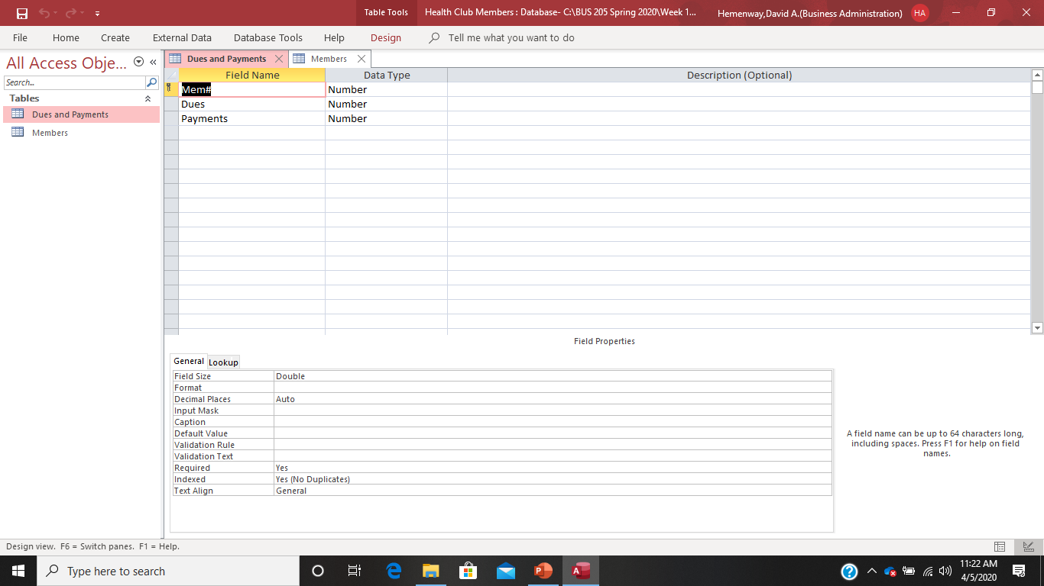
4-Way Test to Determine Relationships
4- In the Access database are the two field properties the same?

Slide 10
Establishing Table Relationships
Relationships should be created after the tables are created, but before any data is entered unless you are getting data from an Excel spreadsheet.
The most common method of connecting two tables is using a primary key from the primary table to the foreign key in the related table.
Relationships between tables are represented by join lines in the Relationships window.
Notes:
The Relationships window allows the user to add tables and create relationships between those tables. Relationships should be created after the tables have been created, but before any sample data is entered into the tables. This allows adjustments to be made without having to also adjust the data.
When two tables are joined in the Relationship window, join lines link the tables based on a common field. The most common method of joining two tables is using a primary key from one table to the foreign key in the related table. A foreign key is a field in one table that is also the primary key of another table. For example, StudentID would be the primary key in the Student table, but the foreign key in the Courses table.

Slide 11
Creating Relationships
A common field—used to relate two tables together.
Join lines—allow relationships between two tables to be created on a common field.
There are three types of relationships used by Access to manage relationships between tables:
1) Enforce referential integrity
2) Cascade update related fields (automatically make changes)
3) Cascade delete related records (automatically delete related data)
Notes:
A common field is used as a connection between two tables.
When joining two tables, join lines allow the user to create a relationship between two tables using the common field. Once the join lines are there, you can determine what type of relationship you want the two tables to have.
There are three types of relationships to determine how Access will manage the relationship between two tables:
Enforce referential integrity
Cascade update related fields
Cascade delete related records
We’ll cover the first one in this chapter, but the last two will be covered in Chapter 2.

Slide 12
Referential Integrity
Ensures that data cannot be entered into a related table unless it first exists in the primary table
Example:
Banks would not want to offer a loan to an individual unless that individual was already established as a customer of the bank.
Thus, the customer has to be entered into the customer table, before a new loan can be made in the loan table with that customer’s ID.
Notes:
One of the most used methods for relationships is enforcing referential integrity. When referential integrity is enforced, you cannot enter a foreign key value in a related table unless the primary key value exists in the primary table. By selecting enforce referential integrity, Access ensures that data cannot be entered into a related table unless it first exists in the primary table.
As an example, a bank would not want to create a new loan record for a customer who does not yet exist in the customer table. A loan not related to a customer does not make sense, so by enforcing referential integrity, the customer must be placed in the Customer table before the loan can be entered into the Loan table. The Loan table uses CustomerID as the foreign key, which links back to the CustomerID in the Customer table.

Slide 13
Types of Table Relationships
One-to-one relationships: Each record in one table is directly linked to one record in another table. There is a direct relationship between the tables. This is a rare type of relationship.
One-to-many relationships: Each record in one table is linked to many records in another table(s). This is the most common relationship.
Many-to-many relationships: This complex relationship actually describes crisscrossing relationships in which the linking field is not the primary key field in either table. To create a many-to-many relationship, an intermediary table called a junction table is needed. This relationship is rare.

Slide 14

My assistant Lexi wants to help, but doesn’t know much about Access, I’m sorry to say!

Slide 15
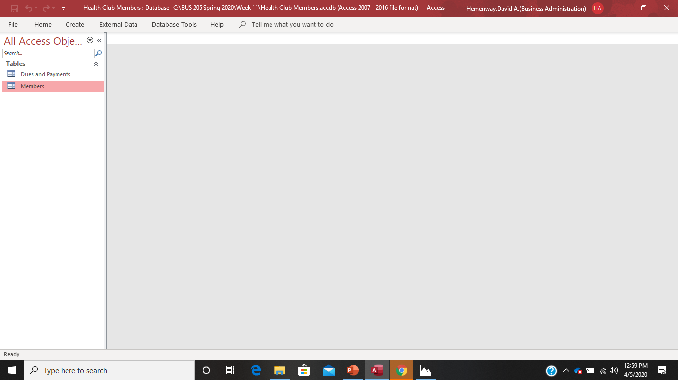
Establishing Table Relationships in Access- Open Access and the Health Club Members Database

Slide 16
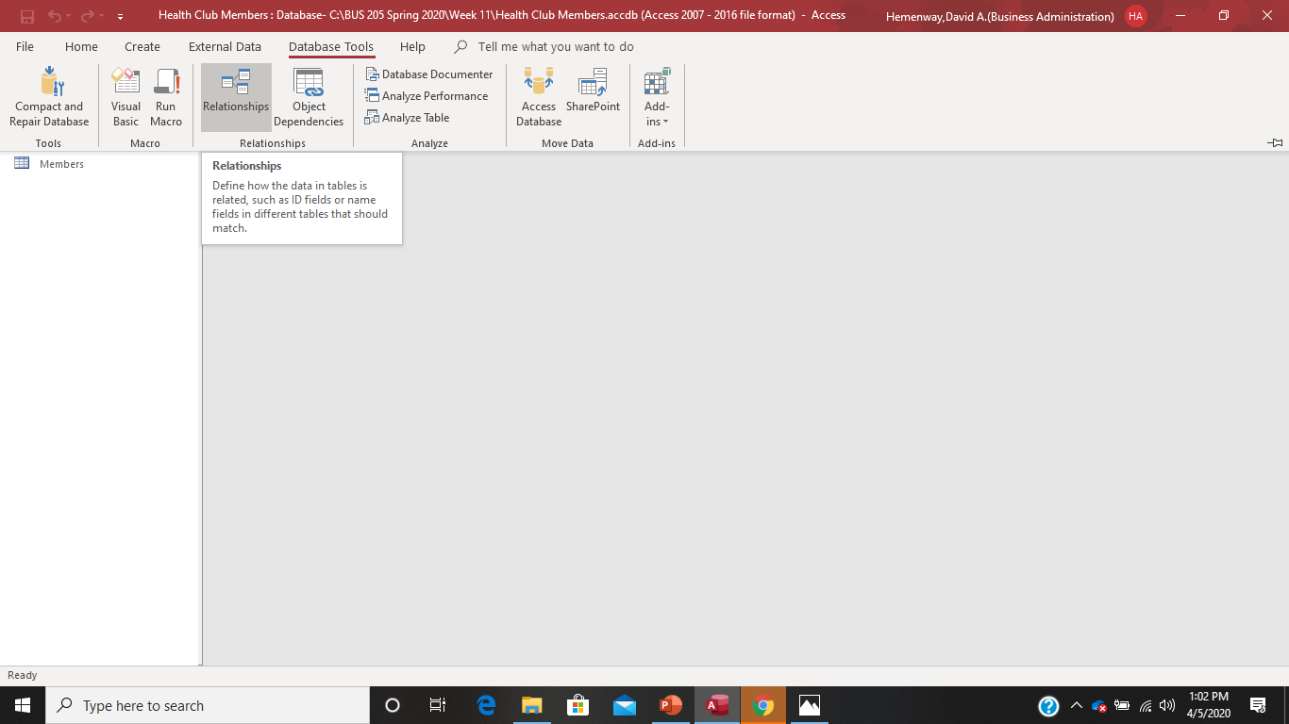
Establishing Table Relationships in Access- Select Database Tools on the main menu then select Relationships

Slide 17
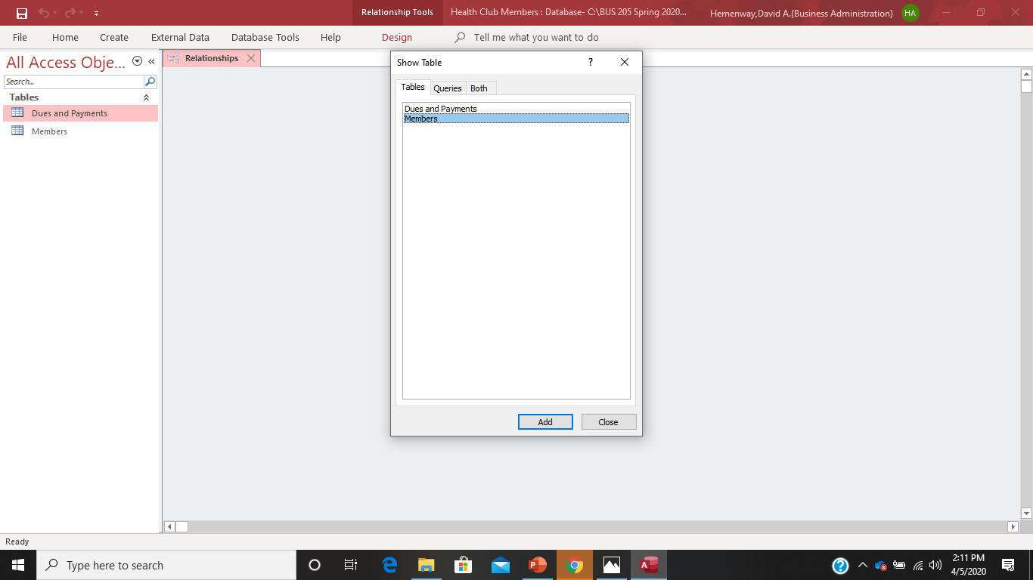
Establishing Table Relationships in Access- Choose the Members table and the Dues and Payments table by highlighting them and selecting add. Select the Members table first because we want to use it’s Mem# as the primary key. The Sum and Payments table is selected second because it will provide the foreign key.

Slide 18
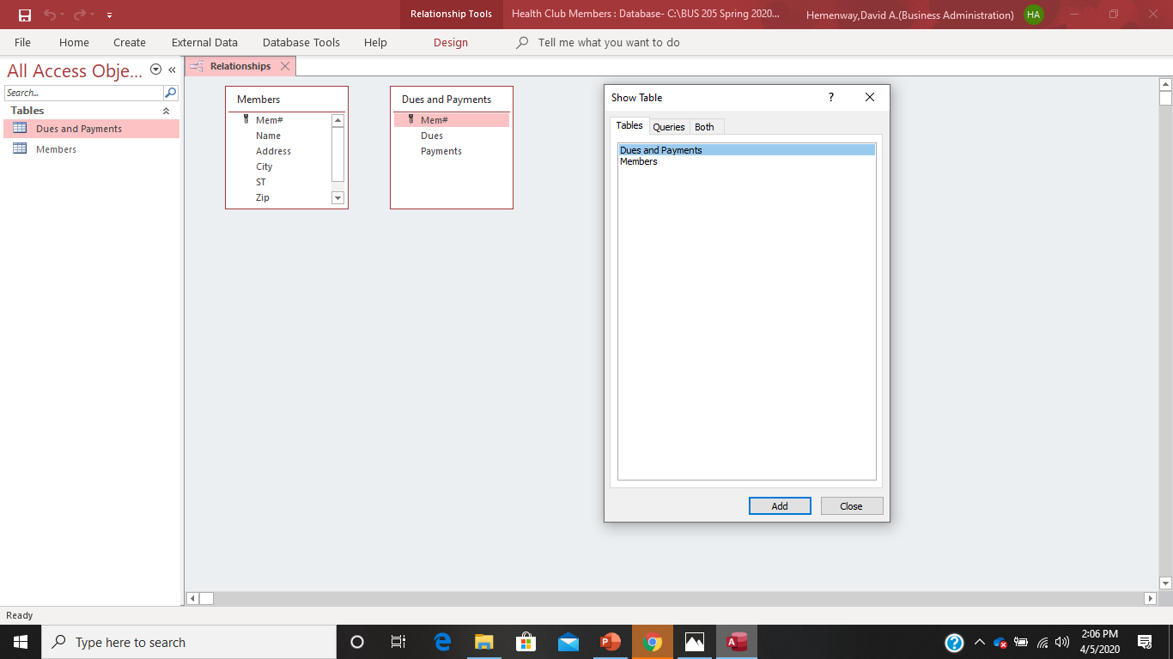
Establishing Table Relationships in Access- Your Access screen should now look like this: If it does, select Close. If it doesn’t, go back and fix what you have done to make it look like this.

Slide 19
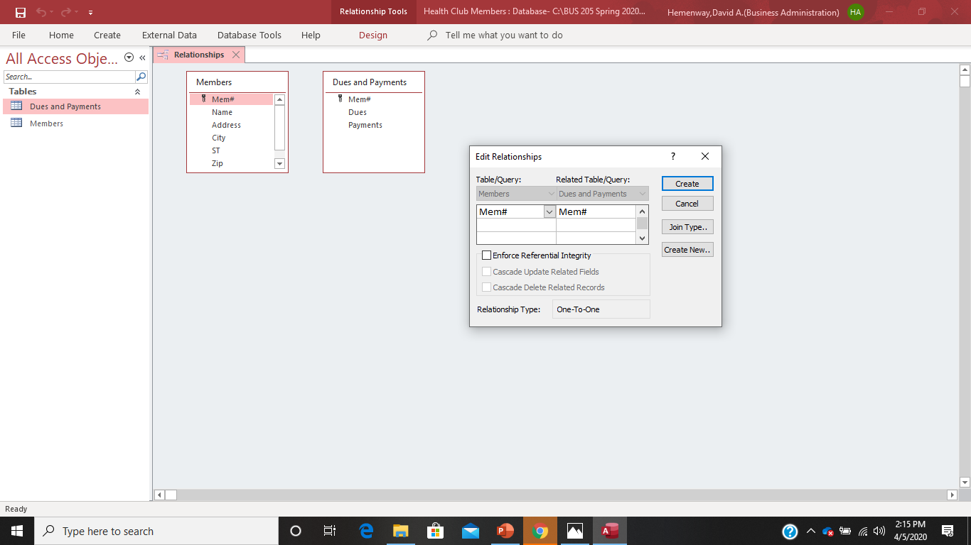
Establishing Table Relationships in Access- Take your cursor and drag Mem# from the Members table to the Dues and Payment table.

Slide 20
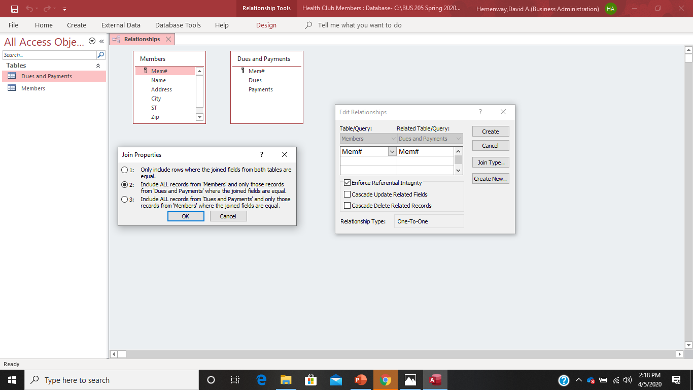
Establishing Table Relationships in Access- Select “Enforce Referential Integrity” and then select “Join Type”

Slide 21
Establishing Table Relationships in Access- We are going to select “Join Type” option 2 because we want to include ALL records from the Members table and only those records from the Dues and Payments table where the joined fields are equal. Once you have made this selection by selecting option 2 and selecting “OK” in the Join Property menu, select “Create” on the Edit Relationships menu.

Slide 22
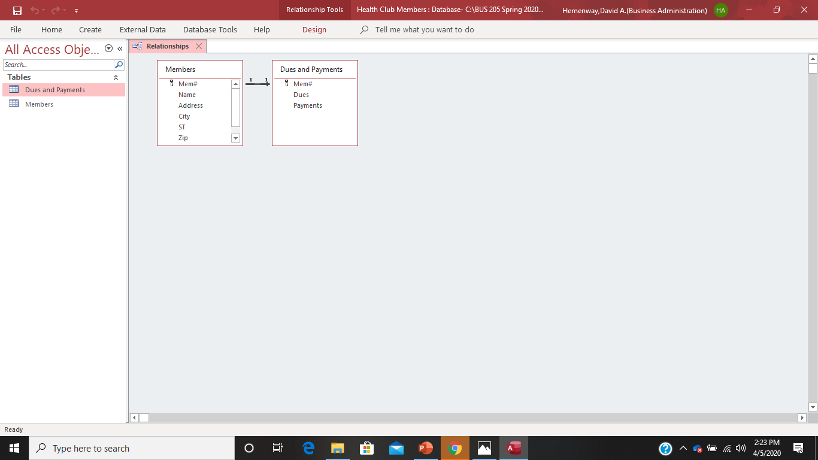
Establishing Table Relationships in Access- Your Access screen should now look like this. You have successfully created your first Access database table join! We have joined two tables with a one to many relationship and referential integrity in force.

Slide 23
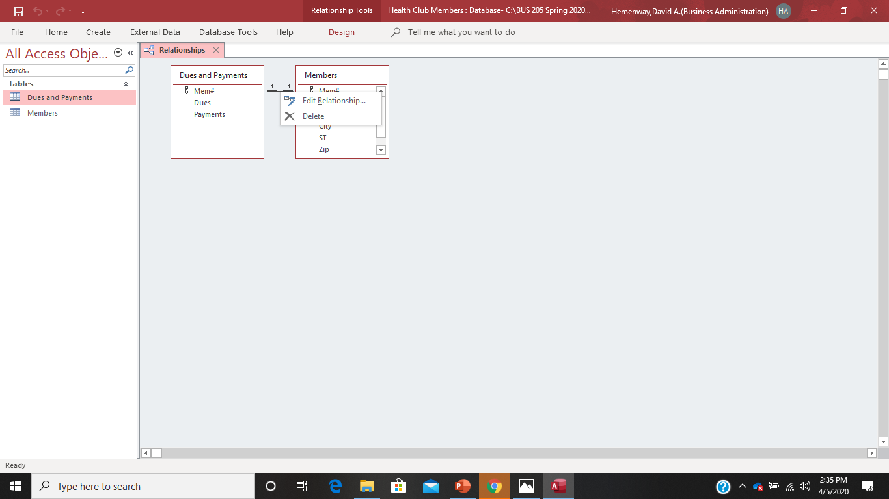
Editing Table Relationships
To edit a table relationship, you need to put your cursor right in the middle of the line between the two tables and right click your mouse. Access is very picky about this! You can either edit or delete a relationship.

Slide 24
Table Normalization
Database normalization is a process used to organize a database into tables and columns. The main idea with this is that a table should be about a specific topic and only supporting topics included. By limiting a table to one purpose you reduce the number of duplicate data contained within your database. This eliminates some issues stemming from database modifications. To achieve these objectives, we’ll use some established rules. As you apply these rules, new tables are formed. The progression from unruly to optimized passes through several normal forms.
Source: https://www.essentialsql.com/get-ready-to-learn-sql-database-normalization-explained-in-simple-english/

Slide 25
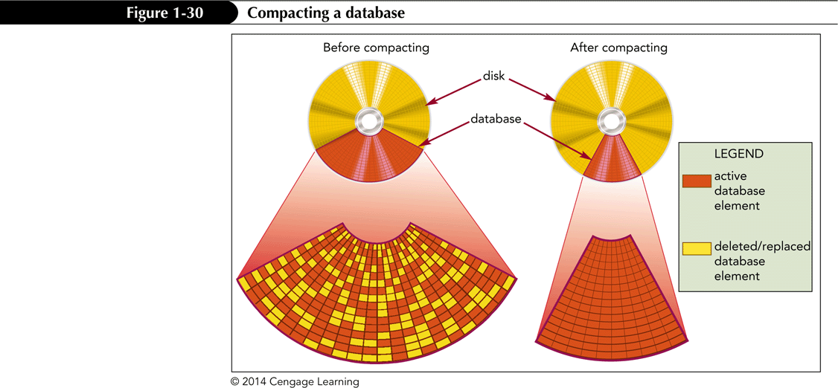
Managing a Database
Activities involved in database management include compacting and repairing a database and backing up and restoring a Database
Compacting and Repairing a Database
Rearranges the data and objects in a database to decrease its file size, thereby making more storage space available and enhancing the performance of the database

Slide 26
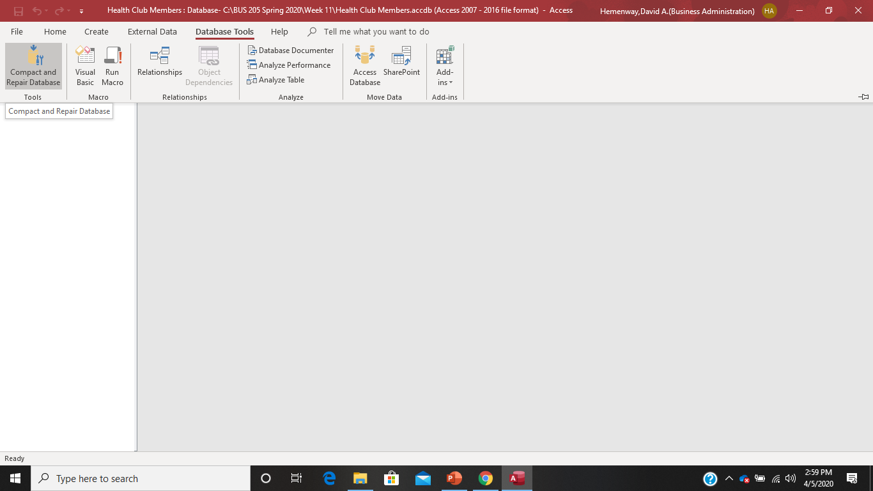
Compacting and Repairing Your Database
Select Database Tools on the main menu and select Compact and Repair Database on the sub menu.

Slide 27
Managing a Database
Backing Up and Restoring a Database
The process of making a copy of the database file to protect your database against loss or damage
The Back Up Database command enables you to back up your database file from within the Access program, while you are working
Steps:
Click the FILE tab to display the Info screen in Backstage view
Click Save As in the navigation bar
Click Back Up Database
Click the Save As button

Slide 28
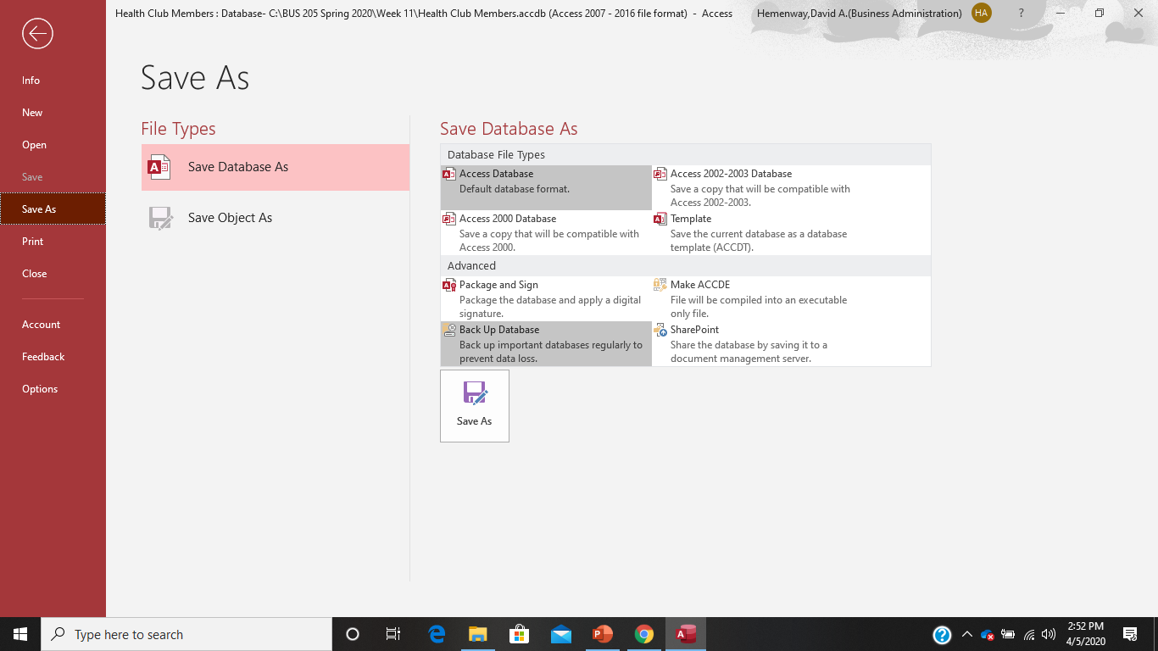
Backing up your Database Click File to get into Backstage view, select Save Database As and then Backup Database

